Slide 1
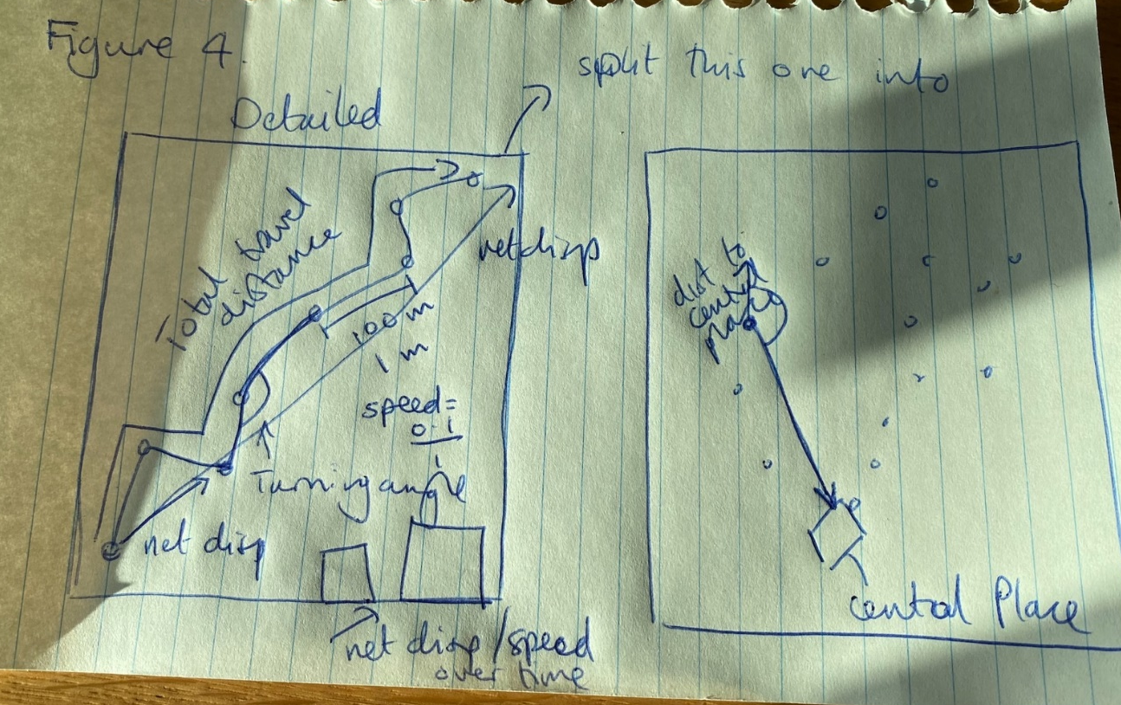

Slide 2
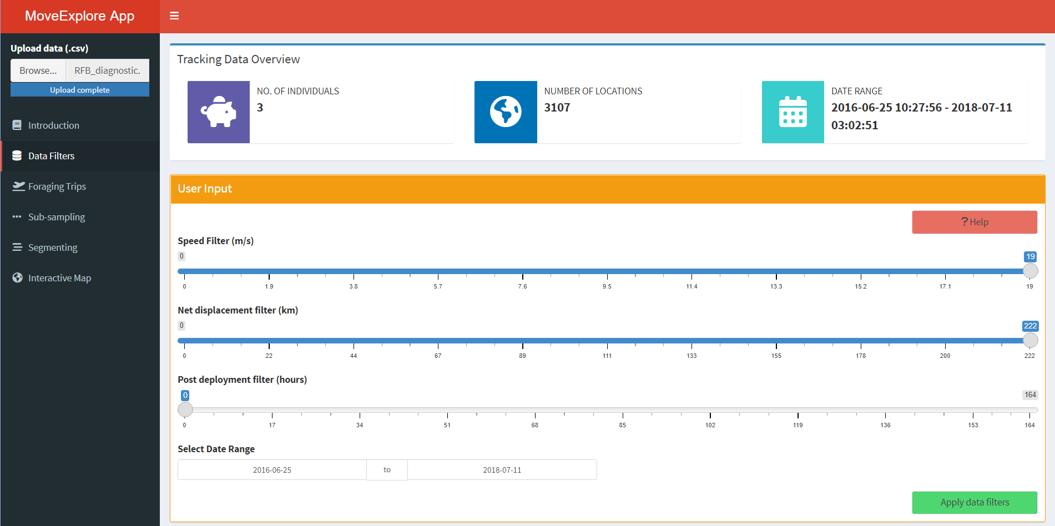
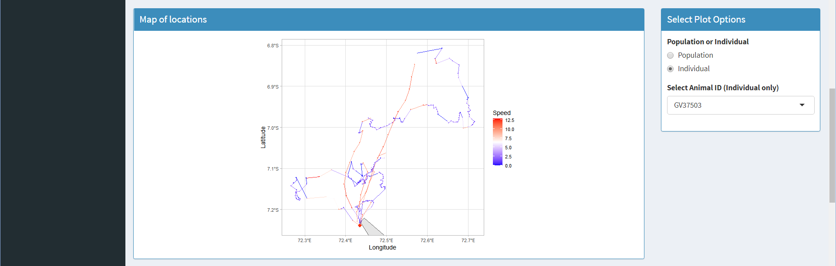
Help Button
Figure 4. section 3.4
Notes:
Have the key bits in the figure that the users really need to interact with. Then label in the figure like the help button above. Include a more detailed description of what each element in the legend.
Figure 3. The data filters tab from the Shiny app to explore tracking data and test effects of filtering parameters. The labelled elements are described in more detailed here. Data upload; search the users system for a file to upload to the app. Sections tab; toggle between different section in the app, for each tab the user input box and outputs will change. Data Summary; summary information of the tracking data that is calculated automatically for the tracking uploaded by the user. User Input box; box that contains filtering parameters that can be manually changed by the user. Slider User Input; drag the slider to change the filtering value. Help Button; Click to pop-up help page that guides users through each tab. Apply Button; button to apply the current filter selection in the user input to the data. Plot selection; change the visualisation of the plot

Slide 3
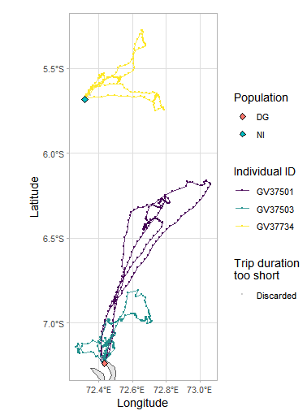
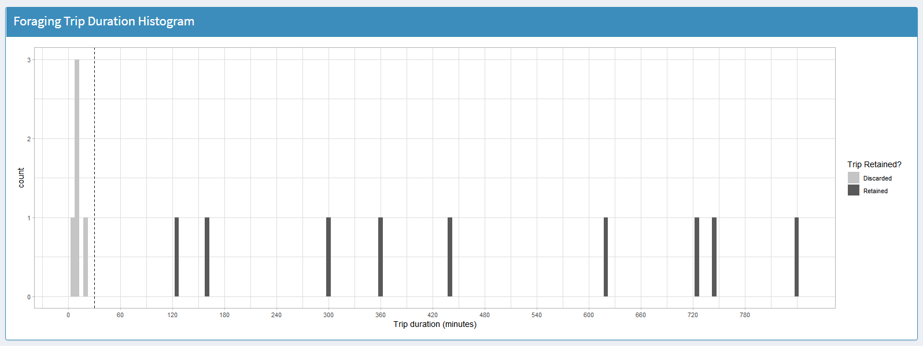
Figure 5. Section 3.5
Notes:
Maybe change to segmenting or re-sampling example.

